Slide 1
Oversight Committee Meeting Presenter: Karen Bruns, Agile Coach CWDS
November 16, 2016

Slide 2

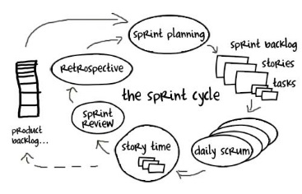

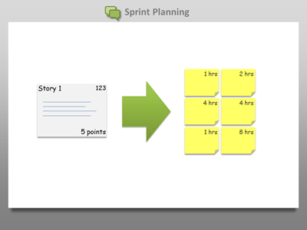

Sprint Planning
Notes:
Every iteration (sprint) begins with the sprint planning session
CWDS has adopted a two week sprint schedule for most teams
Product Owner decides ahead of time which stories are of the highest priority to the release and will generate the highest business value
Team pulls work from the prioritized backlog into the sprint backlog and breaks them into tasks

Slide 3
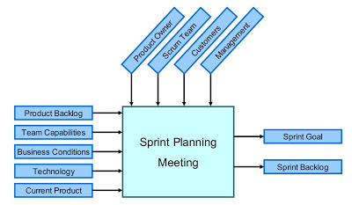
What Happens in Sprint Planning?
Notes:
Generally speaking, sprint planning is where the next sprint is planned, but good teams plan all throughout the sprint
The team comes together to review what’s next up in the iteration in Pivotal Tracker (the repository for the work)
They will verify the user stories (requirements) are ready to work on
Make sure there aren’t any dependencies

Slide 4
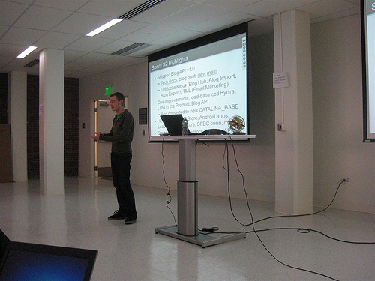
Sprint Review
Notes:
At the end of every iteration (sprint) the sprint review or demo session is held
This is a time for the team to demonstrate the work they finished, share the challenges they had during the sprint/iteration
Sometimes this work will be technical in nature; other times end user functionality will be demonstrated
This is a photo of an actual sprint review/demo in flight

Slide 5
Let’s Take an Insider Look into a CWDS Sprint Review
Intake Sprint Review

Slide 6
For More Information
CWDS Website: https://cwscms.osi.ca.gov/New-System
Email address: CWDS-Communications@dss.ca.gov
Twitter: @CA_CWDS
LinkedIn: https://www.linkedin.com/company/child-welfare-digital-services

